Slide 1
Title page
Project Title: Hotel Booking System (Java Swing + OOP)
Problem Statement:
Manual hotel booking systems are inefficient and error-prone. This project automates room booking, customer management, and data storage.
Target User:
Hotel staff
Managers
Small hotel/lodge administrators
1

Slide 2
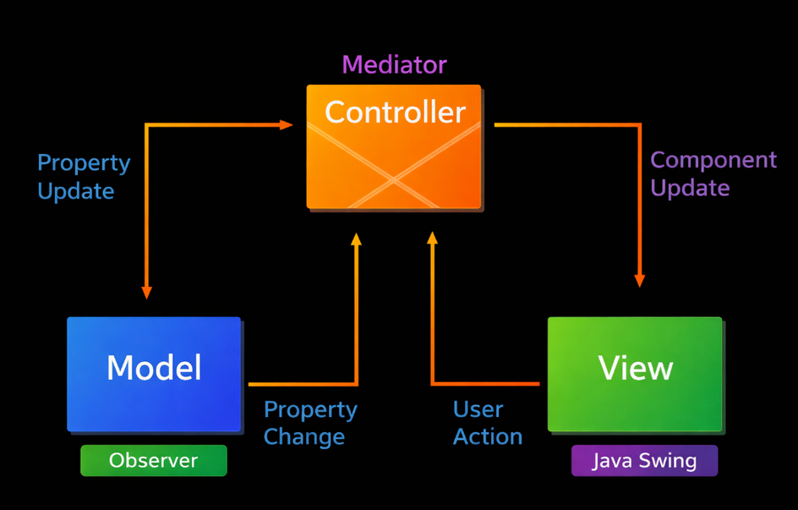
System Design
High-Level Architecture:
Follows MVC structure
Model → Room, Customer, Booking
Service → HotelService, FileService
View → HotelGUI
Key Classes & Responsibilities:
Room → stores room details
Customer → stores customer info
Booking → links room + customer
HotelService → core logic
SaveThread → background saving
Package Structure:
Main → entry point
Model → data classes
Service → business logic
View → GUI
2

Slide 3
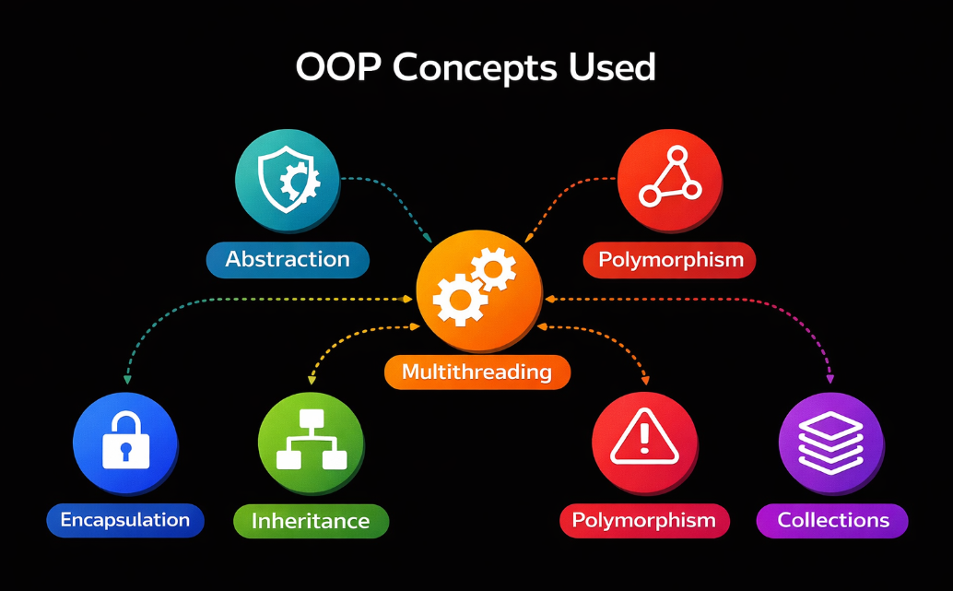
OOP Concepts Used
Abstraction:
- HotelService class
-Methods like bookRoom(), addRoom() hide internal logic
Inheritance:
- SaveThread class
-Extends Thread class
Polymorphism:
- display() method in Room class
-Can be overridden for different room types
Exception handling:
- FileService class,
-Used in file operations with try-catch
Multithreading:
-SaveThread class
-Runs background saving process
Collections:
-ArrayList in HotelService
-Stores rooms and bookings
Design Pattern:
- Follows MVC (Model-View-Controller)
3

Slide 4
Technical Highlight
Design Decision:
-Using multithreading for background saving
Code Logic:
Booking triggers a thread
Thread saves data to file
Why Chosen:
Improves performance
Prevents UI freezing
Simulates real-world concurrent systems
4

Slide 5
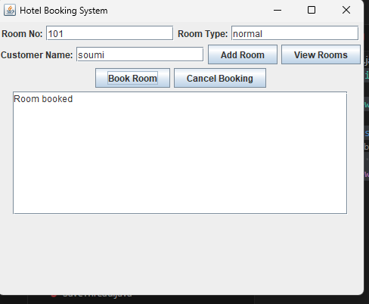
Live Demo
Show Working System:
-Open GUI
-Add room
-View rooms
Demonstrate Scenario:
-Book a room
-Show booking success
-Show data saved
Error Handling Case:
-Try booking same room again
Show “Room already booked”
5

Slide 6
Thank you
for listening!
12024052017058 CSE(IOT-CS-BT) ROLL-56
SOUMI CHAKRABORTY
6

